Slide 1
A robust scalable method for identifying spatially variable genes in spatial transcriptomics
Department of Biostatistics, University of Iowa
Daniel Kakou and Kai Wang
STATGEN 2026, Atlanta
May 19, 2026

Slide 2

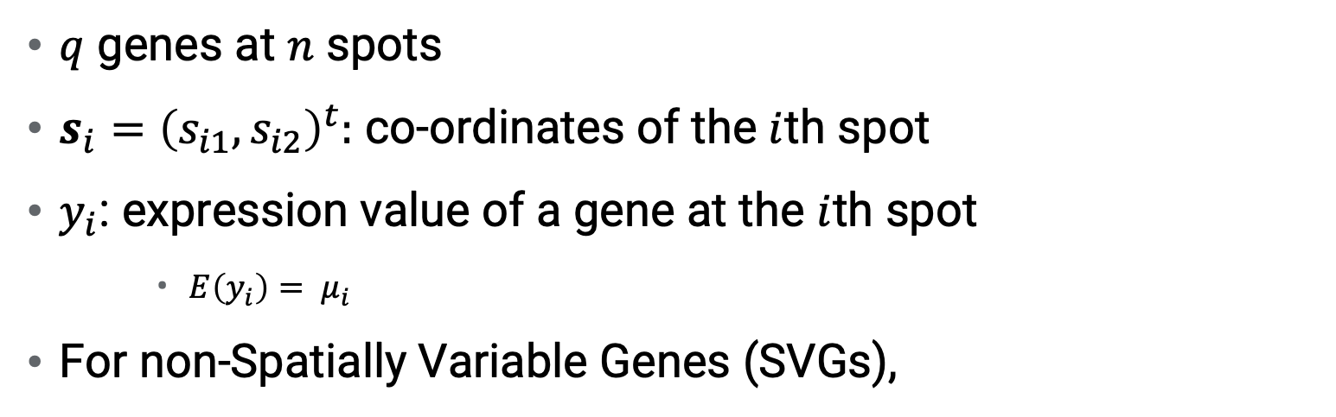
Introduction
$q$ genes at $n$ spots
$s_{i}={\left(s_{i1}, s_{i2}\right)}^{t}:$ co-ordinates of the $i$th spot
$y_{i}$: expression value of a gene at the $i$th spot
    ${E\left(y_{i}\right)= μ}_{i}$
For non-Spatially Variable Genes (SVGs),
$${H_{0}: μ}_{1}=μ_{2}= …=μ_{n}=μ$$

Slide 3

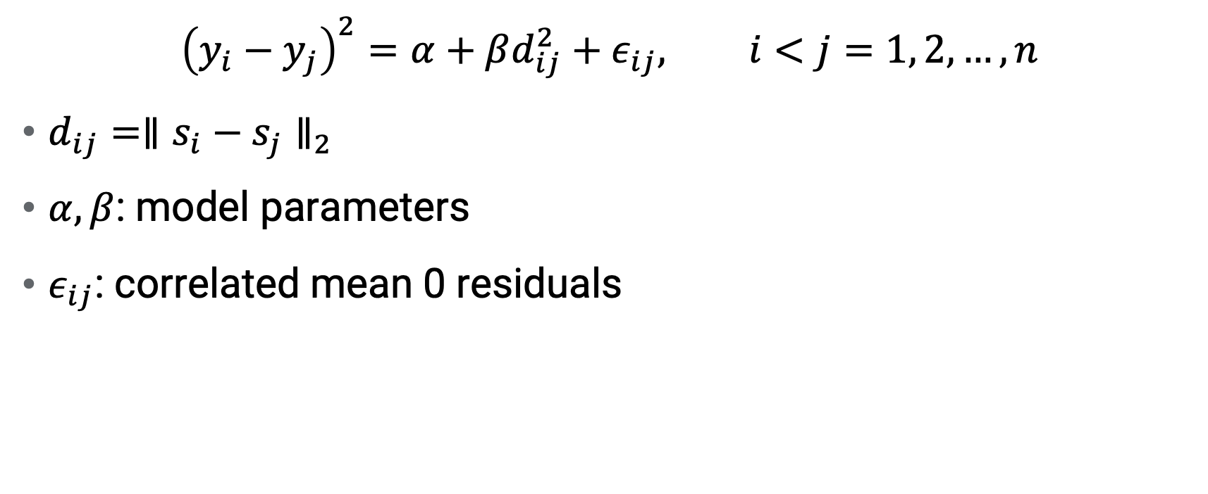
Similarity Regression
$${\left(y_{i}−y_{j}\right)}^{2}=α+βd_{ij}^{2}+ε_{ij}, i<j=1, 2, …, n$$
$d_{ij}={∥s_{i}−s_{j}∥}_{2}$
$α, β$: model parameters
$ε_{ij}$: correlated mean 0 residuals
$$H_{0}:β=0, { H}_{1}:β>0$$

Slide 4
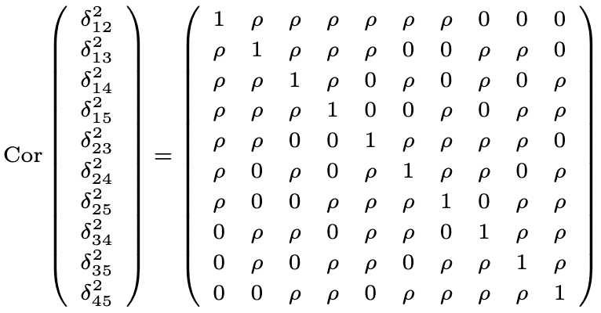


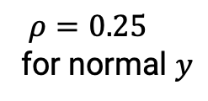
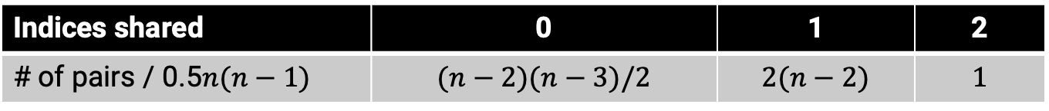
Correlation matrix for $n=5$
$$δ_{ij}=y_{i}−y_{j}$$
$ρ=0.25$
for normal $y$
Indices shared | 0 | 1 | 2
# of pairs / 0.5$n(n−1)$ | $$(n−2)(n−3)/2$$ | $$2(n−2)$$ | $$1$$

Slide 5
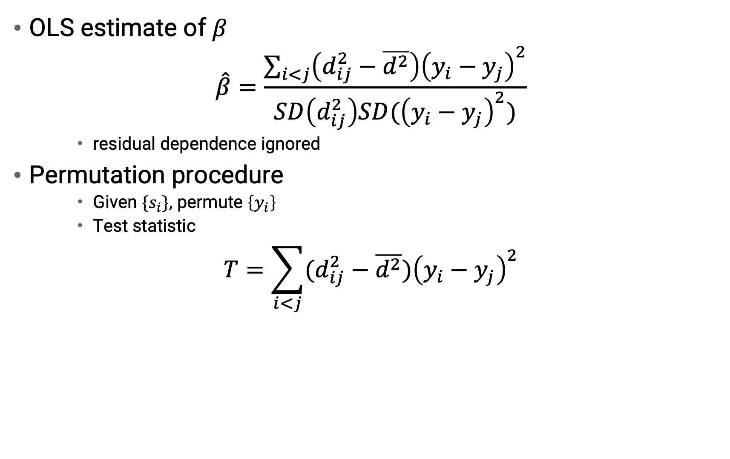
Permutation Statistic
OLS estimate of $β$
$$\hat{β}=\frac{\sum_{i<j}{\left(d_{ij}^{2}−\overline{d^{2}}\right){\left(y_{i}−y_{j}\right)}^{2}}}{SD\left(d_{ij}^{2}\right)SD({\left(y_{i}−y_{j}\right)}^{2})}$$
    residual dependence ignored
Permutation procedure
    Given ${\{s}_{i}\},$ permute $\left\{y_{i}\right\}$
    Test statistic
$$T=\sum_{i<j}{(d_{ij}^{2}−\overline{d^{2}}}){\left(y_{i}−y_{j}\right)}^{2}$$

Slide 6
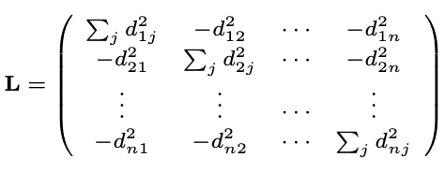

$$T=y^{′}Ly−\overline{d^{2}}y^{′}y≡y^{′}Ly$$
with
is a symmetric Laplacian matrix
  $L1=0$
  $Rank\left(L\right)=n−1$

Slide 7
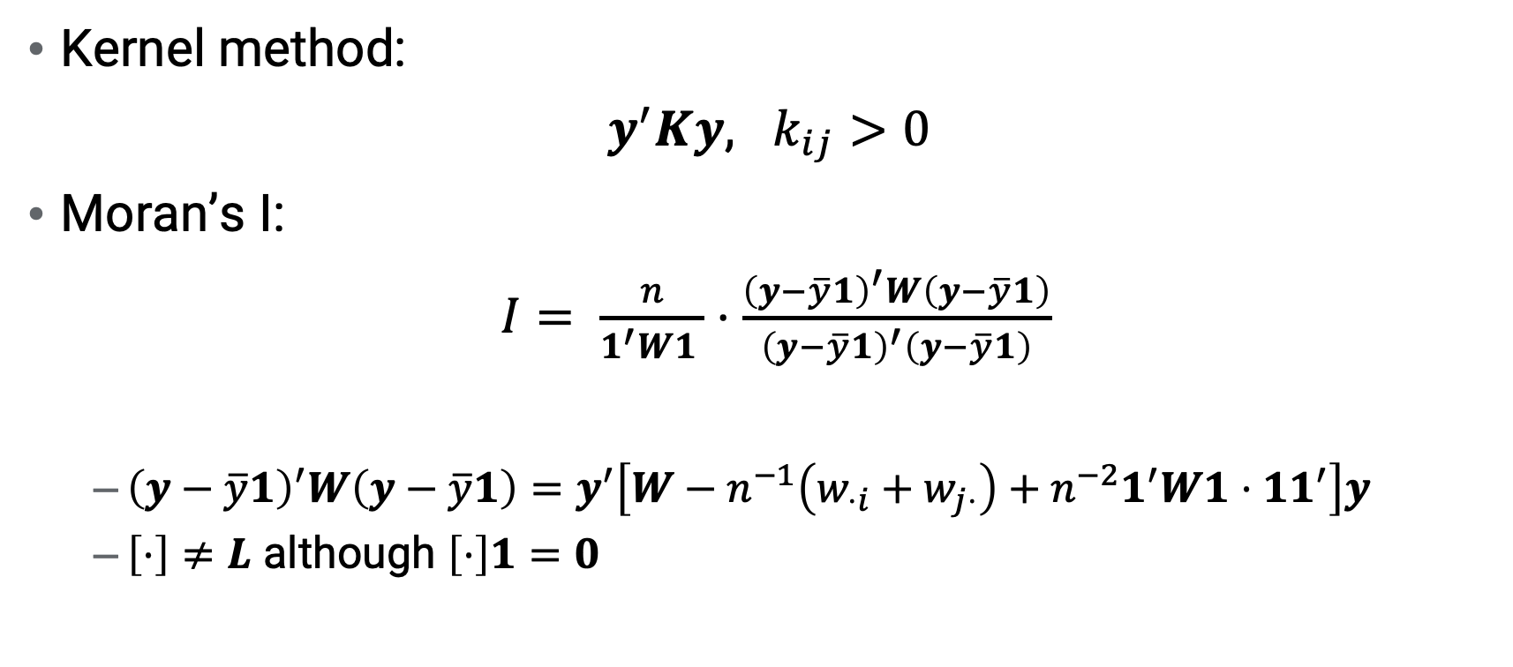
Comparison with existing methods
Kernel method:
$y^{′}Ky$, $k_{ij}>0$
Moran’s I:
$I= \frac{n}{1^{′}W1 }⋅\frac{{\left(y−\overline{y}1\right)}^{′}W\left(y−\overline{y}1\right)}{{\left(y−\overline{y}1\right)}^{′}\left(y−\overline{y}1\right)}$
  ${\left(y−\overline{y}1\right)}^{′}W\left(y−\overline{y}1\right)=y^{′}\left[W−n^{−1}\left(w_{⋅i}+w_{j⋅}\right)+n^{−2}1^{′}W1⋅{11}^{′}\right]y$
  $\left[⋅\right]≠L$ although $\left[⋅\right]1=0$

Slide 8
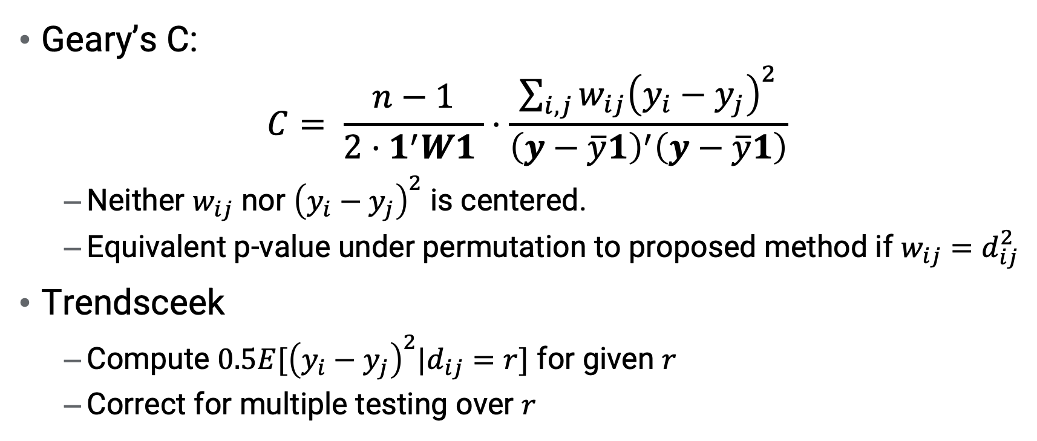
Geary’s C:
$$C= \frac{n−1}{{2⋅1}^{′}W1 }⋅\frac{\sum_{i,j}{w_{ij}{\left(y_{i}−y_{j}\right)}^{2}}}{{\left(y−\overline{y}1\right)}^{′}\left(y−\overline{y}1\right)}$$
  Neither $w_{ij}$ nor ${\left(y_{i}−y_{j}\right)}^{2}$ is centered.
  Equivalent p-value under permutation to proposed method if $w_{ij}=d_{ij}^{2}$
Trendsceek
  Compute $0.5E[{\left(y_{i}−y_{j}\right)}^{2}|d_{ij}=r]$ for given $r$
  Correct for multiple testing over $r$

Slide 9
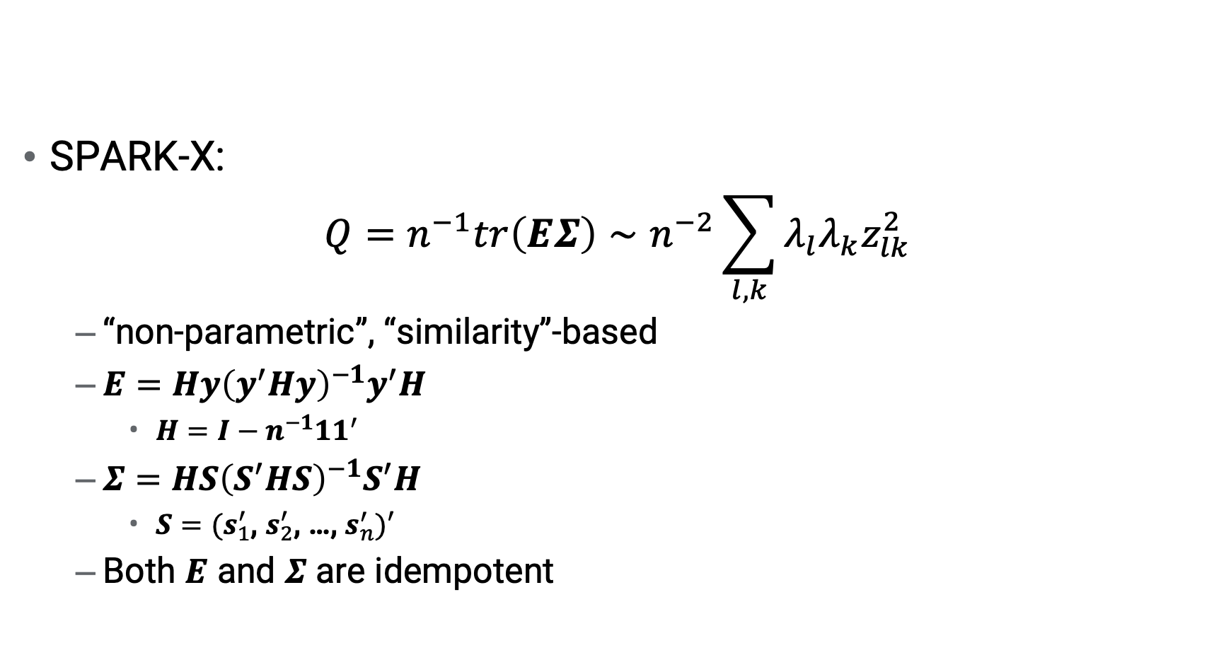
SPARK-X:
$$Q=n^{−1}tr\left(EΣ\right)∼n^{−2}\sum_{l, k}{λ_{l}λ_{k}z_{lk}^{2}}$$
  “non-parametric”, “similarity”-based
  $E=Hy{\left(y^{′}Hy\right)}^{−1}y^{′}H$
    $H=I−n^{−1}{11}^{′}$
  $Σ=HS{\left(S^{′}HS\right)}^{−1}S^{′}H$
    $S=(s_{1}^{′}$, $s_{2}^{′}$, …, $s_{n}^{′})′$
  Both $E$ and $Σ$ are idempotent

Slide 10
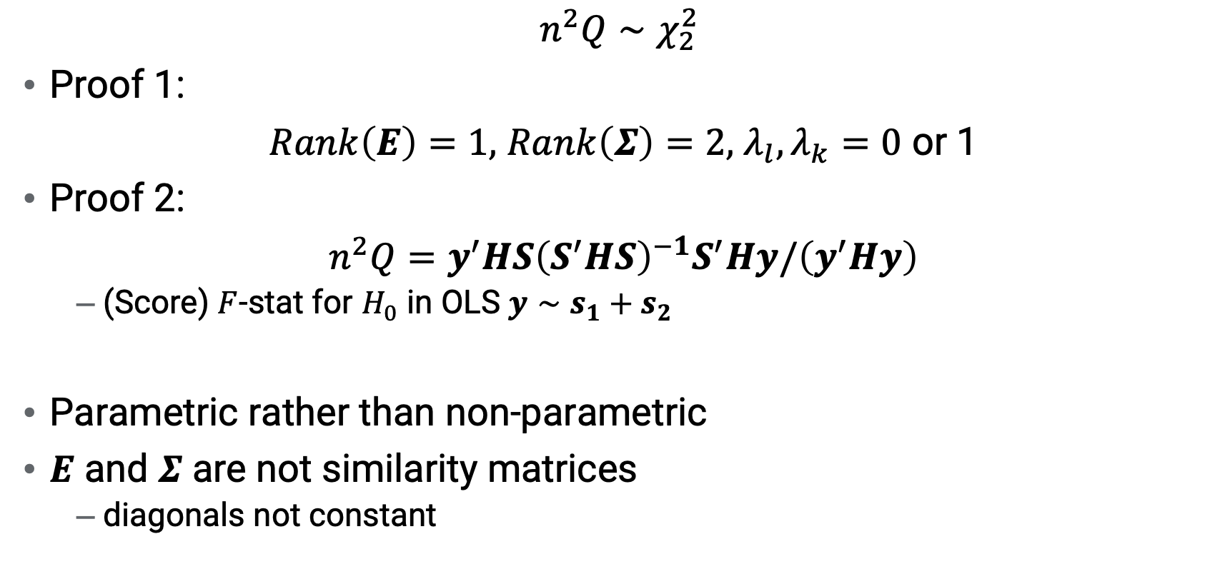
SPARK-X is equivalent to OLS
$$n^{2}Q∼χ_{2}^{2}$$
Proof 1:
$Rank\left(E\right)=1,$ $Rank\left(Σ\right)=2,$ $λ_{l}, λ_{k}=0$ or 1
Proof 2:
$n^{2}Q=y^{′}HS{\left(S^{′}HS\right)}^{−1}S^{′}Hy/\left(y^{′}Hy\right)$
  (Score) $F$-stat for $H_{0}$ in OLS $y∼s_{1}+s_{2}$
Parametric rather than non-parametric
$E$ and $Σ$ are not similarity matrices
  diagonals not constant

Slide 11
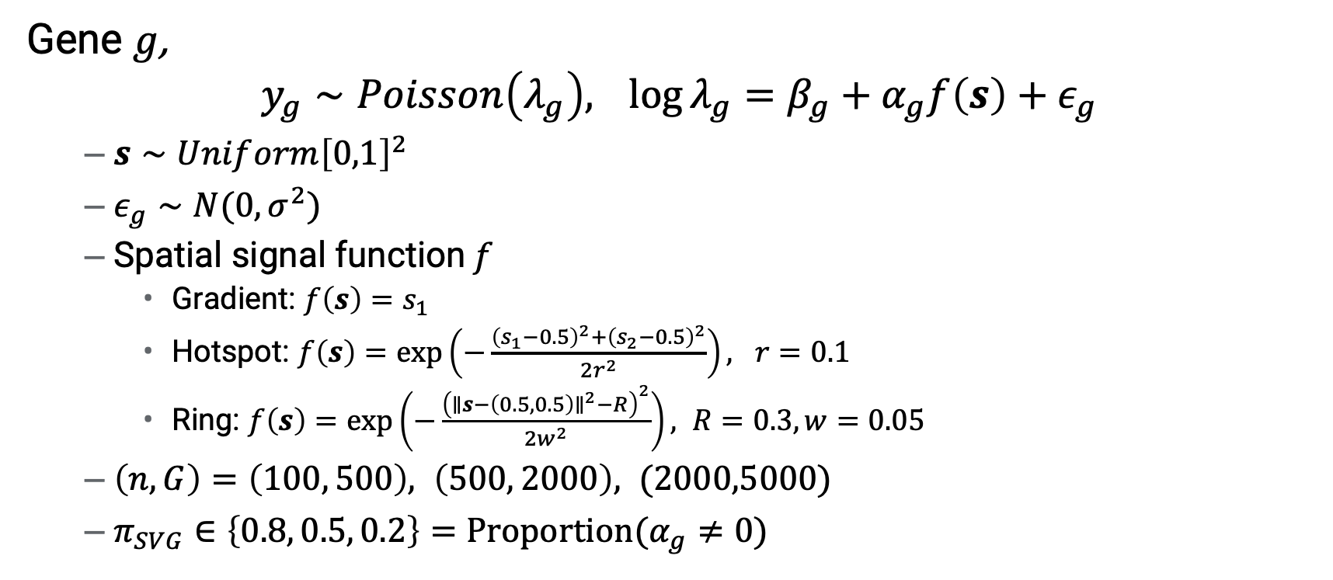
Simulation
Gene$g$,
$$y_{g}∼Poisson\left(λ_{g}\right),\log{λ_{g}}=β_{g}+α_{g}f\left(s\right)+ε_{g}$$
  $s∼Unif{orm\left[0,1\right]}^{2}$
  $ε_{g}∼N(0, σ^{2})$
  Spatial signal function$f$
    Gradient: $f\left(s\right)=s_{1}$
    Hotspot: $f\left(s\right)=exp\left(−\frac{{\left(s_{1}−0.5\right)}^{2}+{\left(s_{2}−0.5\right)}^{2}}{2r^{2}}\right), r=0.1$
    Ring: $f\left(s\right)=exp\left(−\frac{{\left(∥s−\left(0.5, 0.5\right)∥^{2}−R\right)}^{2}}{2w^{2}}\right), R=0.3, w=0.05$
  $\left(n, G\right)=\left(100, 500\right), \left(500, 2000\right), (2000,5000)$
  $π_{SVG}∈\left\{0.8, 0.5, 0.2\right\}=Proportion(α_{g}≠0)$

Slide 12
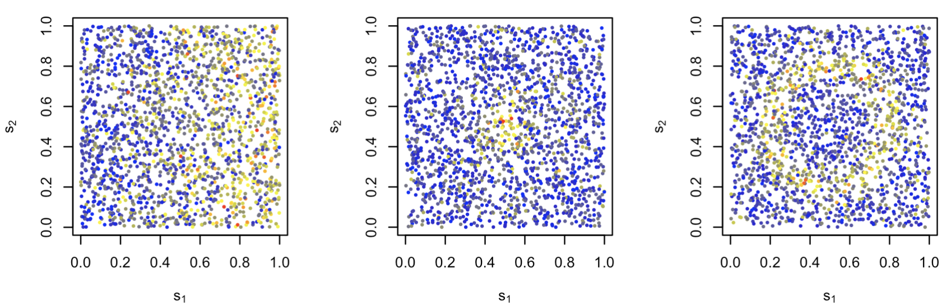
Simulated Spatial Signal Patterns
2,000 spots
1 gene

Slide 13
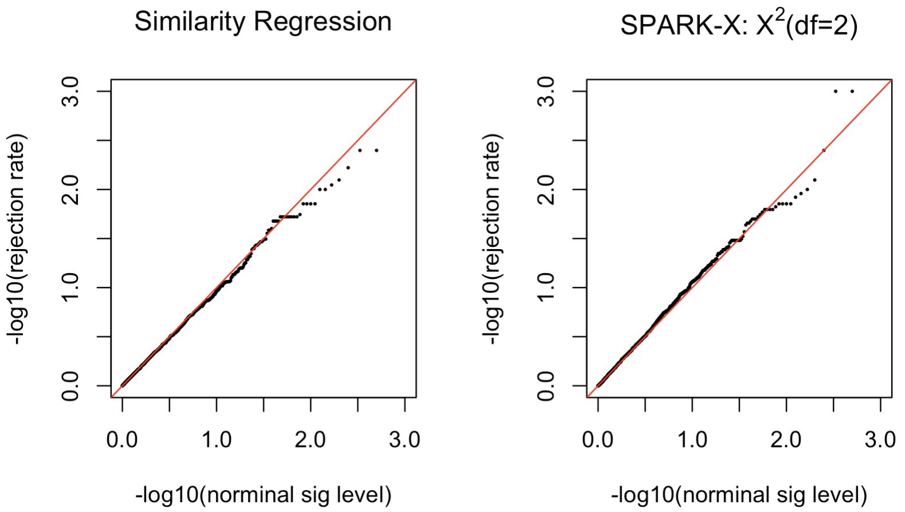
Type I Error Rate
200 spots

Slide 14
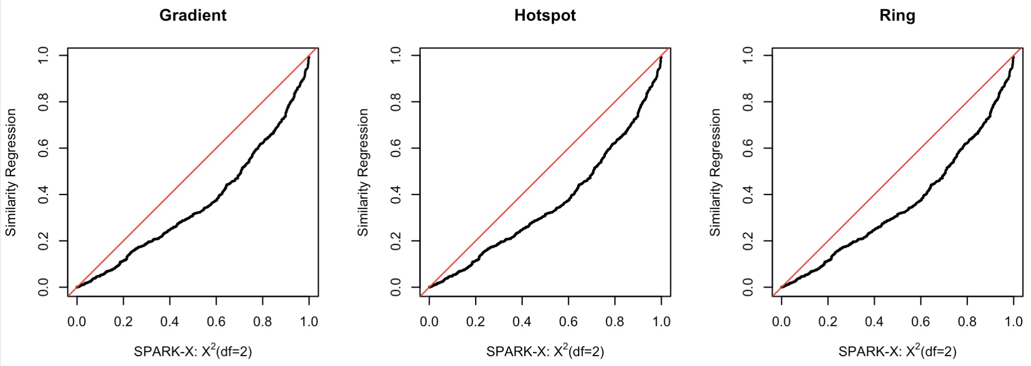
Power
200 spots

Slide 15
Conclusion
Similarity regression
Analytical comparison with existing methods
  SPARK-X: Chi-square(df=2)
To do:
Use an analytical distribution
Explore other similarity measures than Euclidean distance
Allow for residual correlation in similarity regression

Slide 16
References
Su, H., Wu, Y., Chen, B. et al. STANCE: a unified statistical model to detect cell-type-specific spatially variable genes in spatial transcriptomics. Nat Commun 16, 1793 (2025). https://doi.org/10.1038/s41467-025-57117-w
Tushar Ghosh. (2026). CytoKspace: A Graph-Based Kernel Test for Detecting Spatially Variable Patterns in Spatial Transcriptomics Data. ENAR 2026 Spring Meeting.
Zhang K, Peters J, Janzing D, Schölkopf B. Kernel-based conditional independence test and application in causal discovery. In: Proceedings of the 27th Conference on Uncertainty in Artificial Intelligence; 2011. p. 804–13.
Zhu, J., Sun, S. and Zhou, X., 2021. SPARK-X: non-parametric modeling enables scalable and robust detection of spatial expression patterns for large spatial transcriptomic studies. Genome Biology, 22(1), p.184.

Slide 17

Thank You

