Slide 1
Valid two-sample Mendelian randomization with invalid instruments
Department of Biostatistics, University of Iowa
Kai Wang, PhD
Department of
ENAR, Indianapolis
March 16, 2026
Joint work with Grace Z. Wang

Slide 2
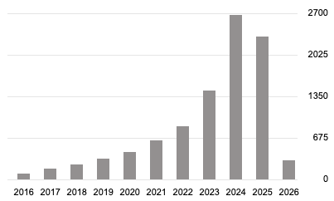
MR-Egger Paradox
MR-Egger regression
  Invalid instrument SNPs
Commonly used
Sensitive to how the way instrument SNPs are coded (Lin et al. 2022)
Citation on Bowden et al. (2015)
Google Scholar, accessed 3/9/2026

Slide 3
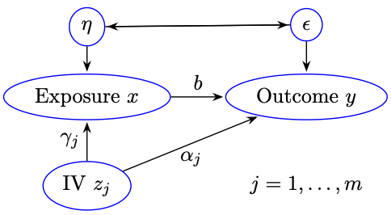
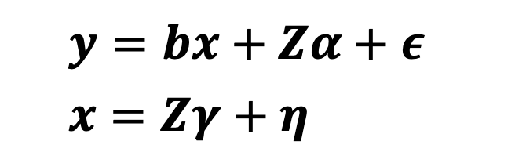

Method
One-sample model:
Key Assumptions:
  Instrument Effect independent of Direct Effect (IEiDE):
  Instrument SNPs are in linkage equilibrium
$$y=bx+Zα+ε \\ x=Zγ+η$$
$$Cov\left(Zγ,Zα\right)=0$$

Slide 4
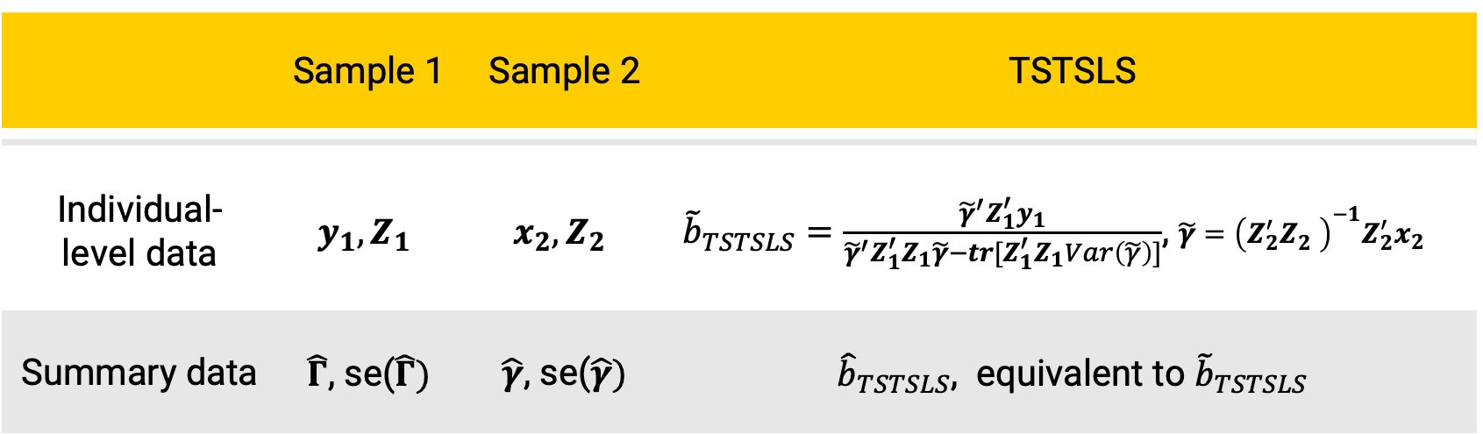

TSTSLS: Two-sample two-stage least squares
 | Sample 1 | Sample 2 | TSTSLS
Individual- level data | $$y_{1}, Z_{1}$$ | $$x_{2}, Z_{2}$$ | ${\tilde{b}}_{TSTSLS}=\frac{{\tilde{γ}}^{′}Z_{1}^{′}y_{1}}{{\tilde{γ}}^{′}Z_{1}^{′}Z_{1}\tilde{γ}−tr[Z_{1}^{′}Z_{1}Var\left(\tilde{γ}\right)]}$, $\tilde{γ}={\left(Z_{2}^{′}Z_{2}^{}\right)}^{−1}Z_{2}^{′}x_{2}$
Summary data | $\hat{Γ}$, se($\hat{Γ})$ | $\hat{γ}$, se($\hat{γ})$ | ${\hat{b}}_{TSTSLS}$, equivalent to ${\tilde{b}}_{TSTSLS}$
Two sample IEiDE: $Cov\left({Z_{1}γ, Z}_{1}α\right)=0$

Slide 5
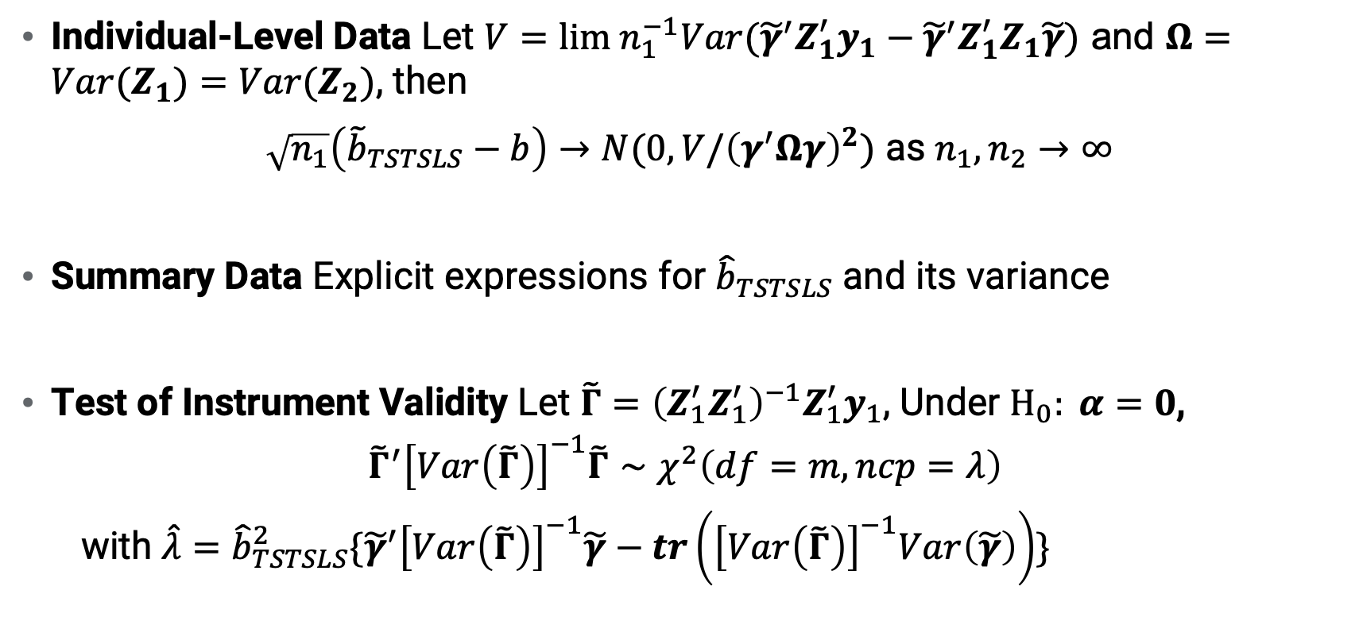
Results
Individual-Level Data Let $V={lim n}_{1}^{−1}Var({\tilde{γ}}^{′}Z_{1}^{′}y_{1}−{\tilde{γ}}^{′}Z_{1}^{′}Z_{1}\tilde{γ})$ and $Ω=Var(Z_{1})=Var(Z_{2})\text{,}$ then
$\sqrt{n_{1}}\left({\tilde{b}}_{TSTSLS}−b\right)→N(0,V/{\left(γ^{′}Ωγ\right)}^{2})$ as $n_{1}, n_{2}→∞$
Summary Data Explicit expressions for ${\hat{b}}_{TSTSLS}$ and its variance
Test of Instrument Validity Let $\tilde{Γ}={\left(Z_{1}^{′}Z_{1}^{′}\right)}^{−1}Z_{1}^{′}y_{1}$, Under $H_{0}: α=0$,
$${\tilde{Γ}}^{′}{\left[Var\left(\tilde{Γ}\right)\right]}^{−1}\tilde{Γ}∼χ^{2}\left(df=m, ncp=λ\right)$$
  with $\hat{λ}={\hat{b}}_{TSTSLS}^{2}\{{\tilde{γ}}^{′}{\left[Var\left(\tilde{Γ}\right)\right]}^{−1}\tilde{γ}−tr\left({\left[Var\left(\tilde{Γ}\right)\right]}^{−1}Var\left(\tilde{γ}\right)\right)\}$

Slide 6
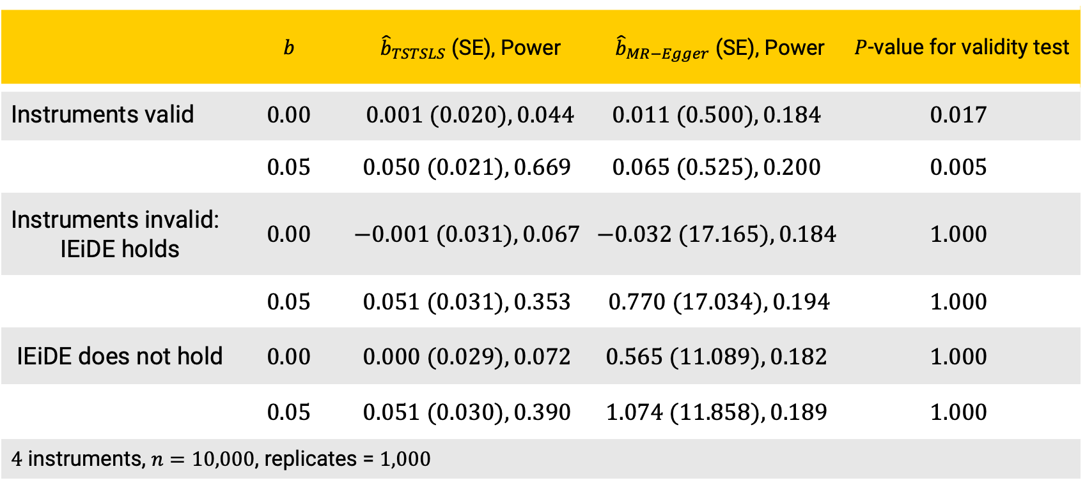
Simulation
 | $$b$$ | ${\hat{b}}_{TSTSLS}$ (SE), Power | ${\hat{b}}_{MR−Egger}$ (SE), Power | $P$-value for validity test
Instruments valid | $$0.00$$ | $$0.001 (0.020), 0.044$$ | $$0.011 (0.500), 0.184$$ | $$0.017$$
 | $$0.05$$ | $$0.050 (0.021), 0.669$$ | $$0.065 (0.525), 0.200$$ | $$0.005$$
Instruments invalid: IEiDE holds | $$0.00$$ | $$−0.001 (0.031), 0.067$$ | $$−0.032 (17.165), 0.184$$ | $$1.000$$
 | $$0.05$$ | $$0.051 (0.031), 0.353$$ | $$0.770 (17.034), 0.194$$ | $$1.000$$
IEiDE does not hold | $$0.00$$ | $$0.000 (0.029), 0.072$$ | $$0.565 (11.089), 0.182$$ | $$1.000$$
 | $$0.05$$ | $$0.051 (0.030), 0.390$$ | $$1.074 (11.858), 0.189$$ | $$1.000$$
$4$ instruments, $n=10,000$, replicates = $1,000$

Slide 7
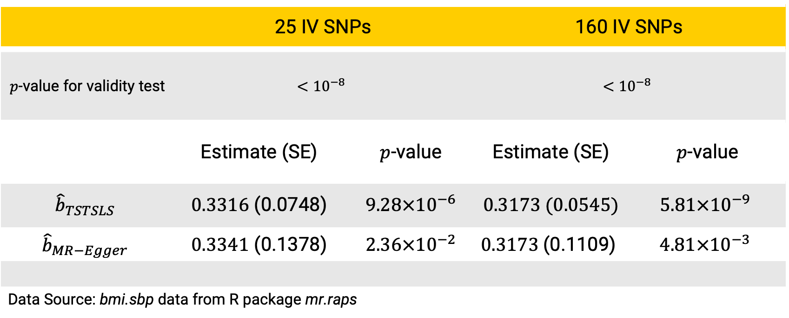
Causal Effect of BMI on SBP
 | 25 IV SNPs |  | 160 IV SNPs
$p$-value for validity test | $$<{10}^{−8}$$ |  | $$<{10}^{−8}$$
 | Estimate (SE) | $p$-value | Estimate (SE) | $p$-value
$${\hat{b}}_{TSTSLS}$$ | $0.3316$ (0.0748) | $9.28×{10}^{−6}$ | $0.3173 (0.0545)$ | $$5.81×{10}^{−9}$$
$${\hat{b}}_{MR−Egger}$$ | $0.3341$ (0.1378) | $2.36×{10}^{−2}$ | $$0.3173 \text{(0.1109)}$$ | $$4.81×{10}^{−3}$$
Data Source: bmi.sbp data from R package mr.raps

Slide 8
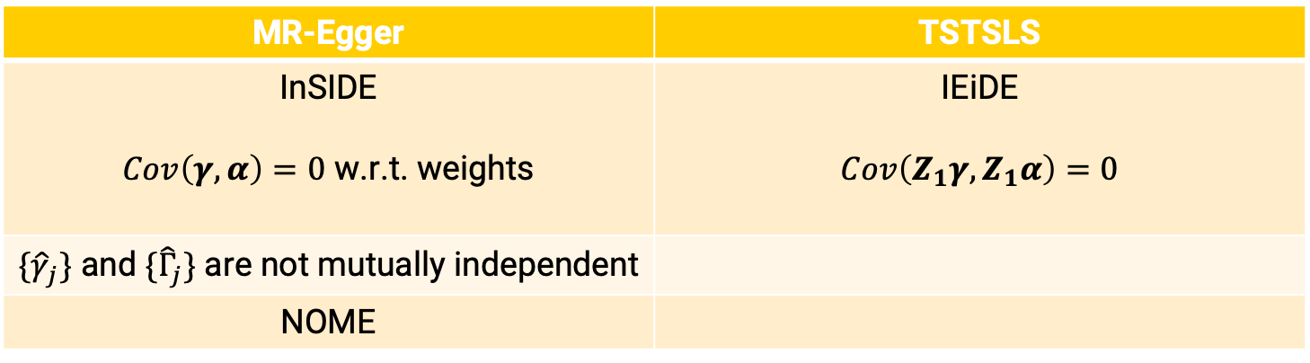

What’s Wrong with MR-Egger
Weighted least squares regression:
$${\hat{b}}_{MR−Egger}: {\hat{Γ}}_{j}∼b_{0}+b {\hat{γ}}_{j}, weight w_{j}=1/Var({\hat{Γ}}_{j})$$
MR-Egger | TSTSLS
InSIDE $Cov\left(γ, α\right)=0$ w.r.t. weights | IEiDE $$Cov\left({Z_{1}γ, Z}_{1}α\right)=0$$
$\{{\hat{γ}}_{j}\}$ and $\{{\hat{Γ}}_{j}\}$ are not mutually independent
NOME

Slide 9
Conclusion
Stop using MR-Egger or its variations
  One false assumption needs more assumptions to compensate
Proposed methods
  Not affected by genotype recoding
  Implemented in R package iGasso

Slide 10
References
Bowden J, Davey Smith G, Burgess S. (2015). Mendelian randomization with invalid instruments: effect estimation and bias detection through Egger regression. International Journal of Epidemiology. 44 (2), 512–525.
Koles´ar M, Chetty R, Friedman J, Glaeser E, Imbens GW. (2015). Identification and inference with many invalid instruments. Journal of Business & Economic Statistics. 33 (4), 474–484.
Lin Z, Pan I, Pan W. (2022). A practical problem with Egger regression in Mendelian randomization. PLoS Genetics. 18 (5), e1010166.

Slide 11

Thank You

